Slide 1
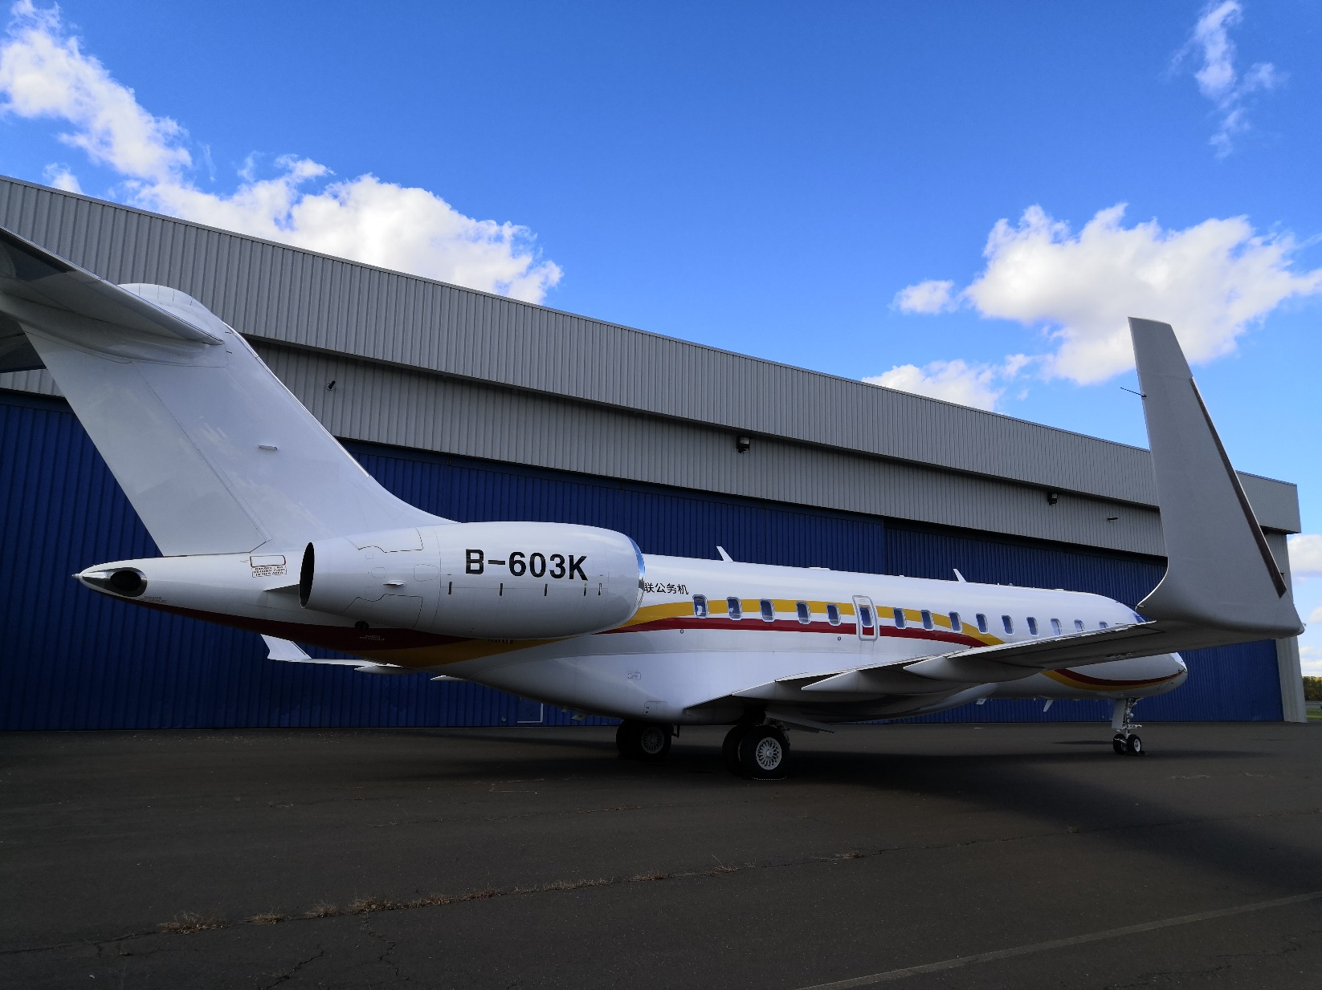
GL5000

Slide 2
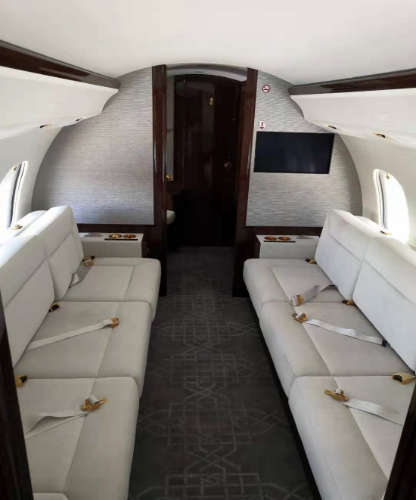
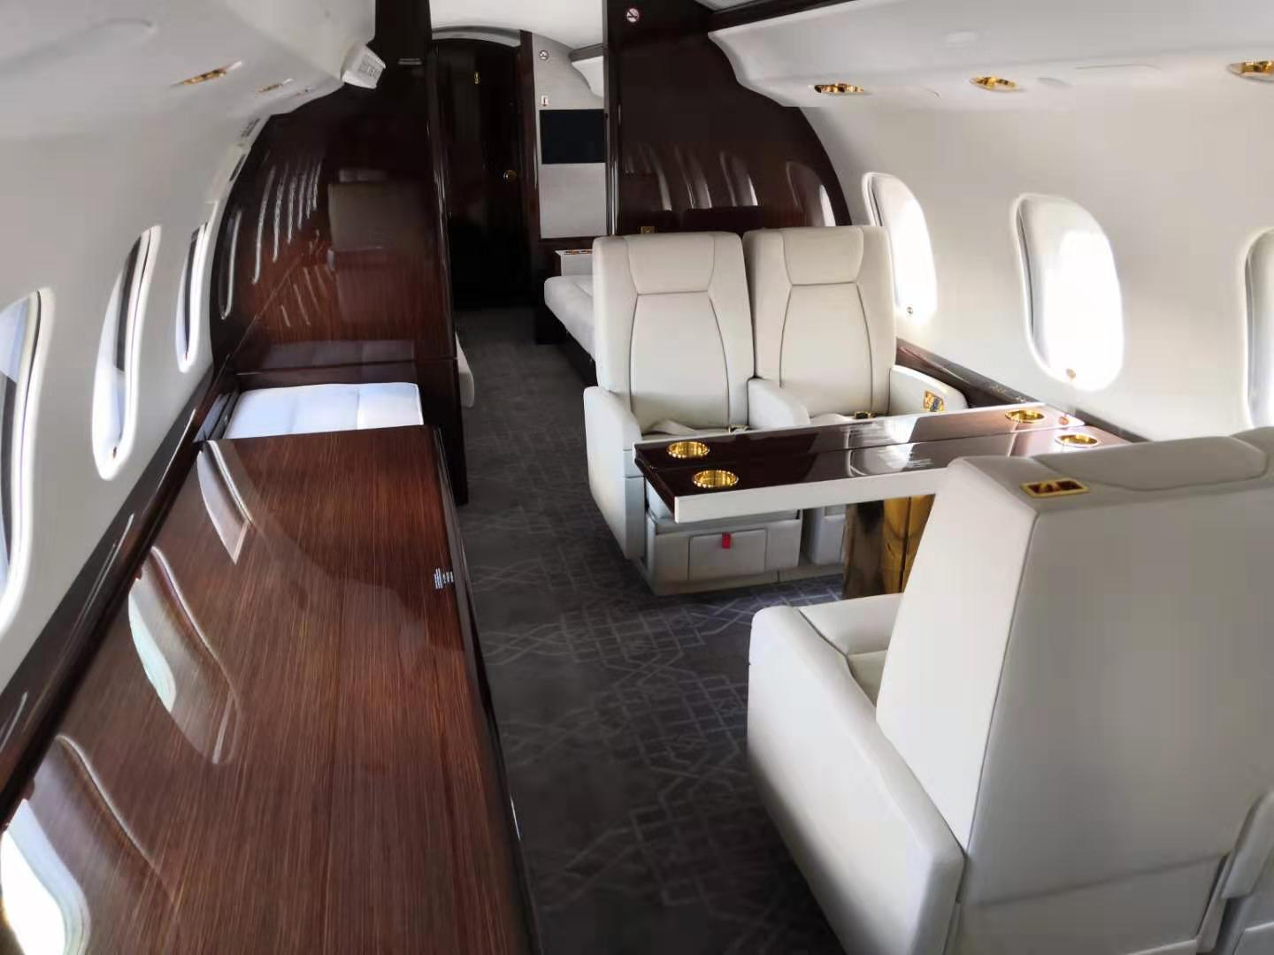
Aircraft information
SN 9501
Delivery Date： 2019.05
Manufacturing Date：2013.07
Flight hour/Flight cycle：1962FH/786FC
Passenger cabin 12-14 seats
Engine enrolled the ESP and APU enrolled the MSP
WiFi function
ADS-B function

Slide 3
